Slide 1

Strategic Partnership for Industry 4.0 innovation advanced Training
The audit methodology
Evaluation model for INDUSTRY 4.0

Slide 2
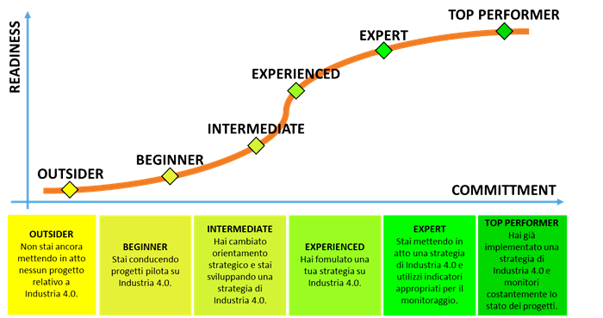
Purpose: measuring the degree of maturity 4.0
Outsider: no project about Industry 4.0
Beginner: implementation of pilot project in limited areas
Intermediate: development of a 4.0 strategy
Experienced: extension of the project in other areas
Expert: development of a culture 4.0
Top Performer: continuous improvement

Slide 3
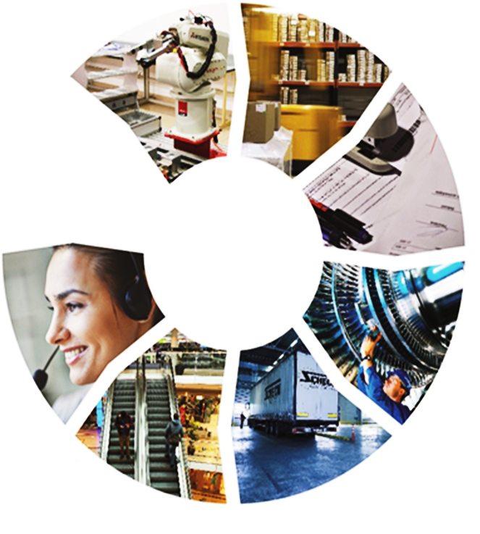
Purpose: identifying WHICH BUSINESS AREAS ARE the MOST CRITICAL
Procurement
Production
Logistics
Sales and Distribution
After sales
Maintenance
Information Technologies
Strategy
Human Resources
…

Slide 4
The main sources of our audit methodology
- DIN SPEC 91345:2016
- Acatech STUDY

Slide 5
The standard DIN SPEC 91345:2016
The DIN SPEC 91345: 2016 standard represents the first attempt to standardize and systematize the new paradigm.
It is the normative reference that outlines the guidelines to adopt the paradigm 4.0.

Slide 6

Asset
How many assets do you identify?
An asset is defined as everything that has value for the organization.
The central concept of Industry 4.0 is that assets can be combined in various ways and that these assets are described with sufficient detail for their use in the digital world.

Slide 7



Asset
Industry 4.0 goal:
every physical asset must be represented virtually in the world of information
DIGITAL DUAL

Slide 8
Characterization of an asset
In terms of information world, an asset can be characterized as follows:
It is known or unknown to some extent
He has a specific state within his life
He has some communication skills
It is represented by information (data)
It has technical features

Slide 9
Acatech study
The general objective of the Acatech study (German Academy of Science and Engineering) is to provide a means to establish the current stages of Industry 4.0 maturity of companies and to identify concrete measures to help them reach a higher maturity stage in order to maximize the economic advantages of Industry 4.0 and digitization.

Slide 10
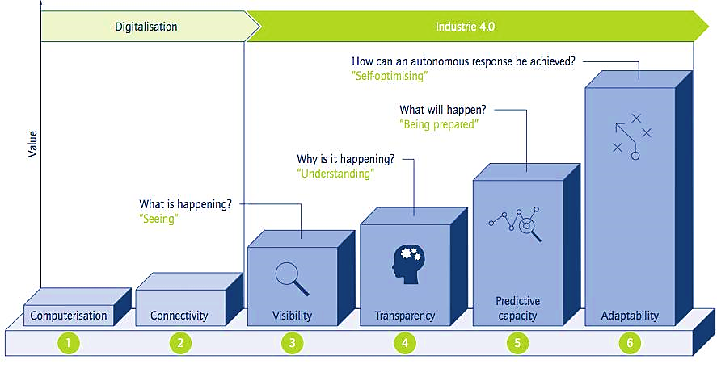


Acatech study: maturity levels

Slide 11


Acatech study: maturity levels
Computerization: initial digitalization through investments in isolated information technologies (eg: CNC machine with numerical control);
Connectivity: innovation of technologies that allow the connection of components;
Visibility: sensorization for data collection;
Transparency: technologies for data analysis (eg: semantic technologies);
Predictive Capacity: ability to simulate future scenarios;
Adaptability: automation of the decision-making process to adapt to changes.

Slide 12
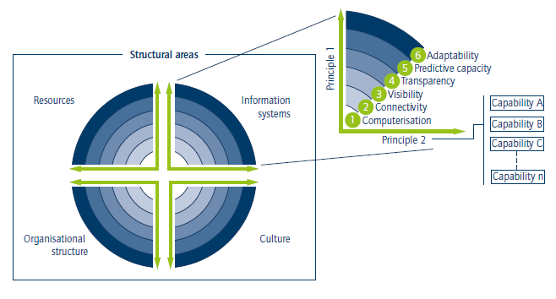
Acatech study: structure
The Acatech model evaluates each functional area of ​​the company by dividing it into 4 structural areas each consisting of 2 axes. Each axis is composed of several evaluation parameters.

Slide 13
To sum up
The DIN SPEC 91346: 2016 standard provides the guidelines for the conceptual industry 4.0 system.
Acatech study provides the levels that identify the maturity of companies from simple digitalization to the achievement of the 4.0 paradigm.

Slide 14
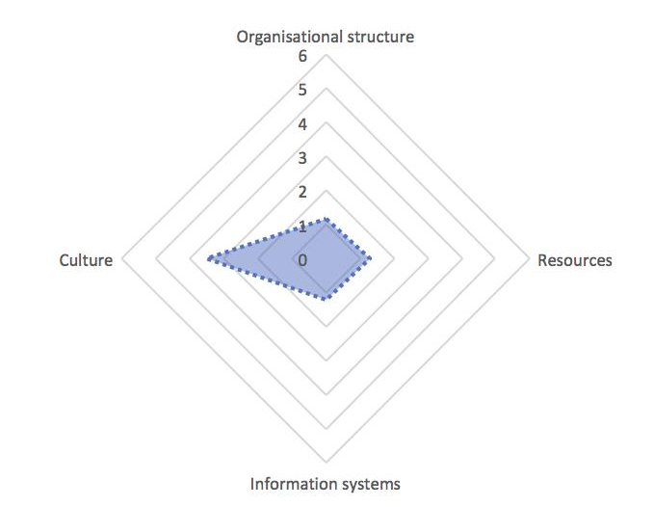
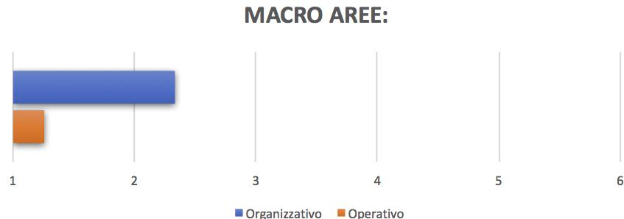


Questionnaire output
First level of detail
Organizational area
Organizational structure
Culture
Operational area
Resources
Information system

Slide 15
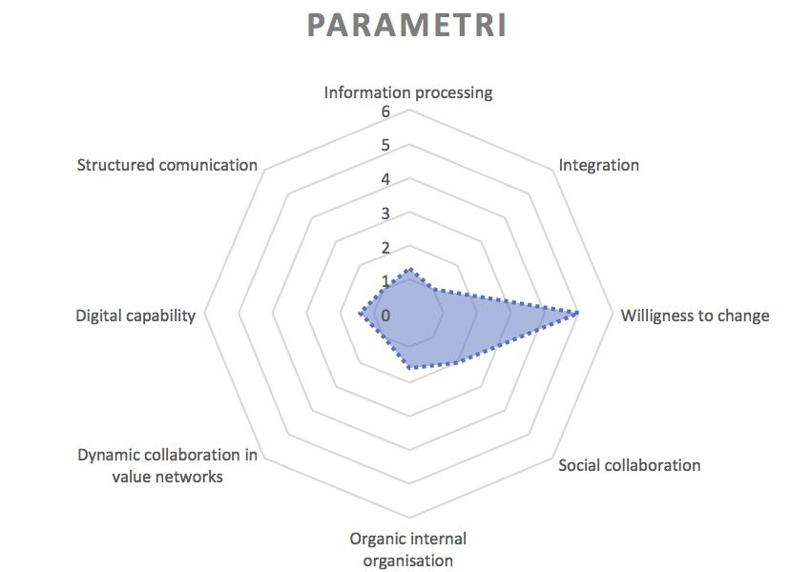



Questionnaire output
Second level of detail
Organizational area
Organizational structure
Dynamic collaboration in value networks
Organic internal organization
Culture
Willingness to change
Social collaboration
Operational area
Information system
Information processing
Integration
Resources
Structured communication
Digital capability

Slide 16

Where to find the audit methodologies?
https://www.sprint40.eu/results/

Slide 17

Thank you for your kind attention!
The European Commission support for the production of this publication does not constitute endorsement of the contents which reflects the views only of the authors, and the Commission cannot be held responsible for any use which may be made of the information contained therein.

